Slide 1

Edge Detection and Resulting Volume Calculation Methods for Liquid Droplet Property Measurement
Alexandra Talbot
ME 0094
Advisor: Douglas Matson

Slide 2
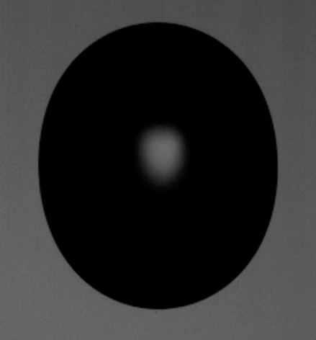
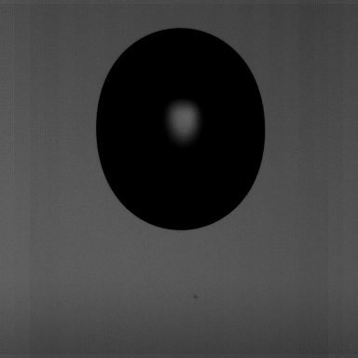
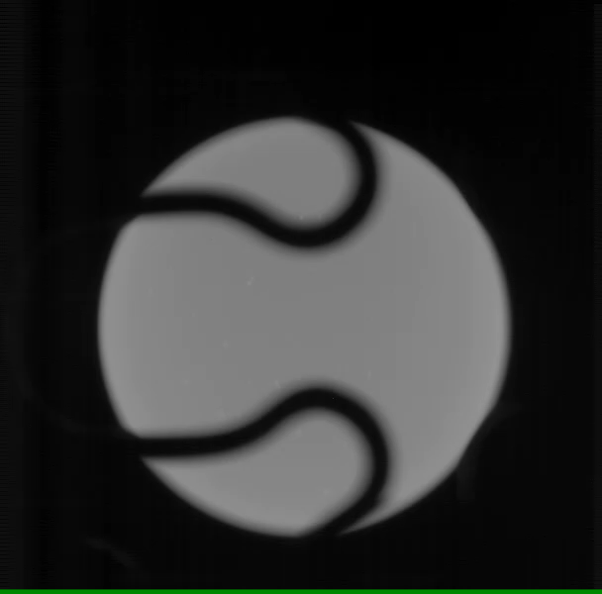
Background
Edge detection is used in image analysis of acoustic and EML/ESL droplet data to define the exterior boundary and then ultimately study thermophysical properties of materials.
Different volume approaches – varying accuracy and precision.
Impose a failure mode for droplets to better understand how experimental data may be rapidly screened to quantify the deviation from ideal deformation behavior.
Acoustic Sample
EML Sample

Slide 3
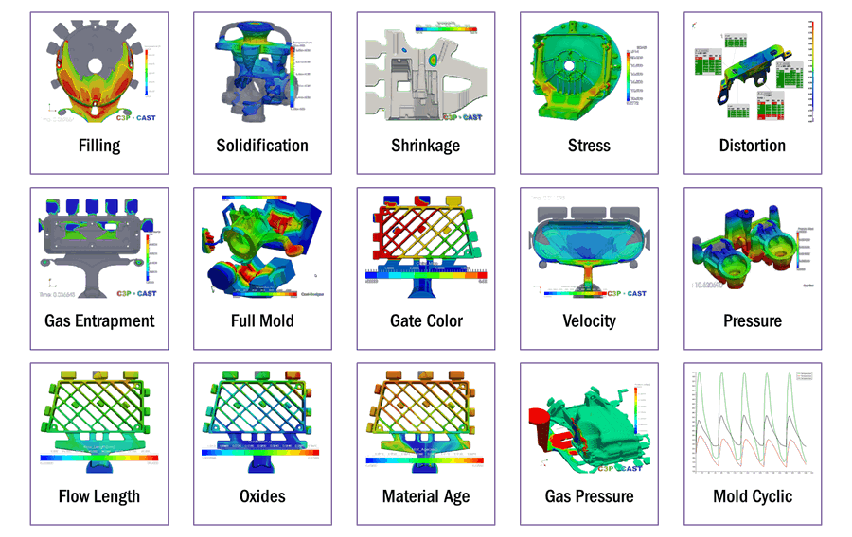
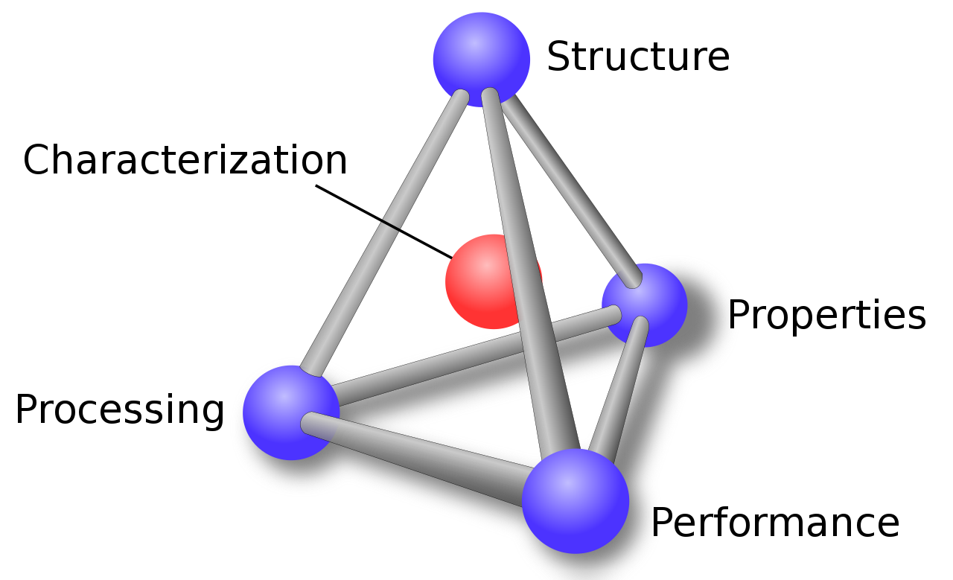
Motivation
Improve the quality of industrial solidification and manufacturing processes through developing mathematical models to predict fluid behavior.
Use thermophysical properties to optimize production routes in advanced material development.
Industrial applications include casting, welding, and additive manufacturing.
https://mechanical-engg.com/blogs/entry/528-what-are-the-rules-that-must-be-kept-in-mind-while-designing-castings/
Issues Encountered during Solidification
Materials Science Tetrahedron

Slide 4


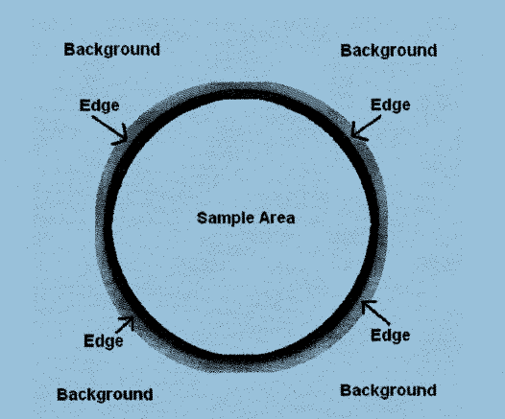
Edge Detection
Edge detection software for typical ESL data
Coarse and sub-pixel edge detection
For the purpose of analytically developing the tools, exterior pixels will be defined manually for edge detection

Slide 5
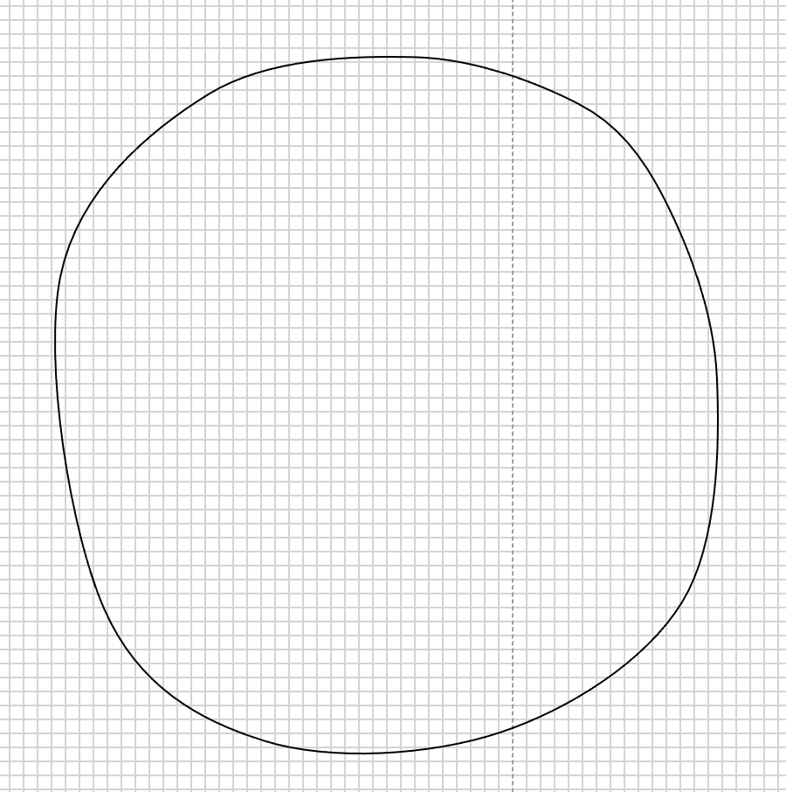
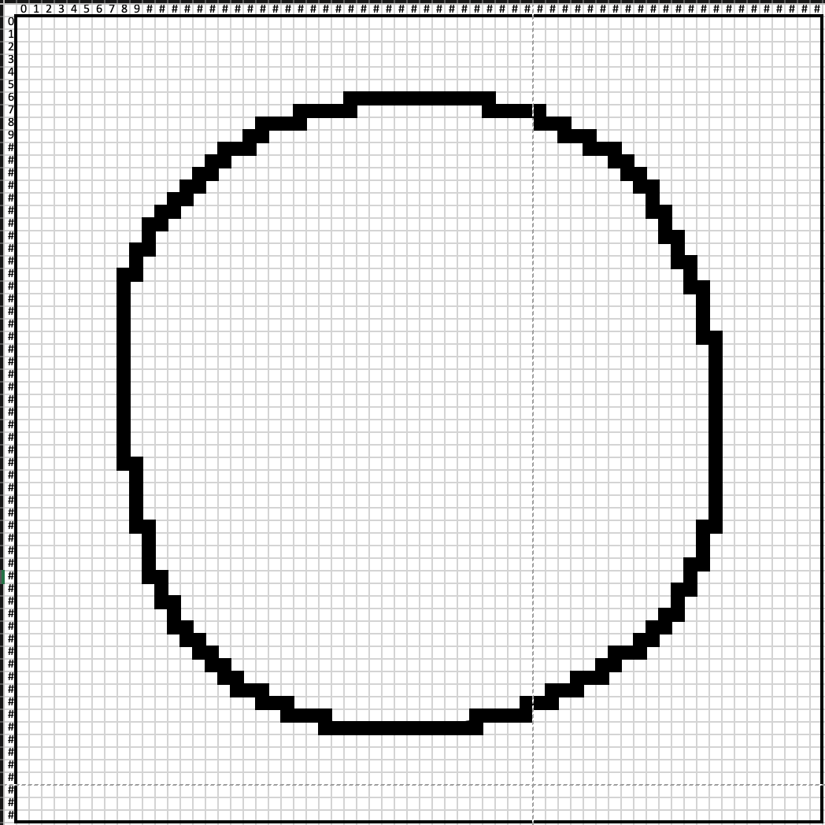
Take non-uniform circular example with super-imposed 64 x 64 grid of pixels and perform edge detection method. Compare the methods using the resulting volume error.

Slide 6
Volume Approaches
Centroid Shell Method
Optimized Axis Shell Method (In Progress)
Rotated Shell Method (In Progress)
Legendre Polynomial Method
Edge Extreme Method
Pixel Summation Method

Slide 7
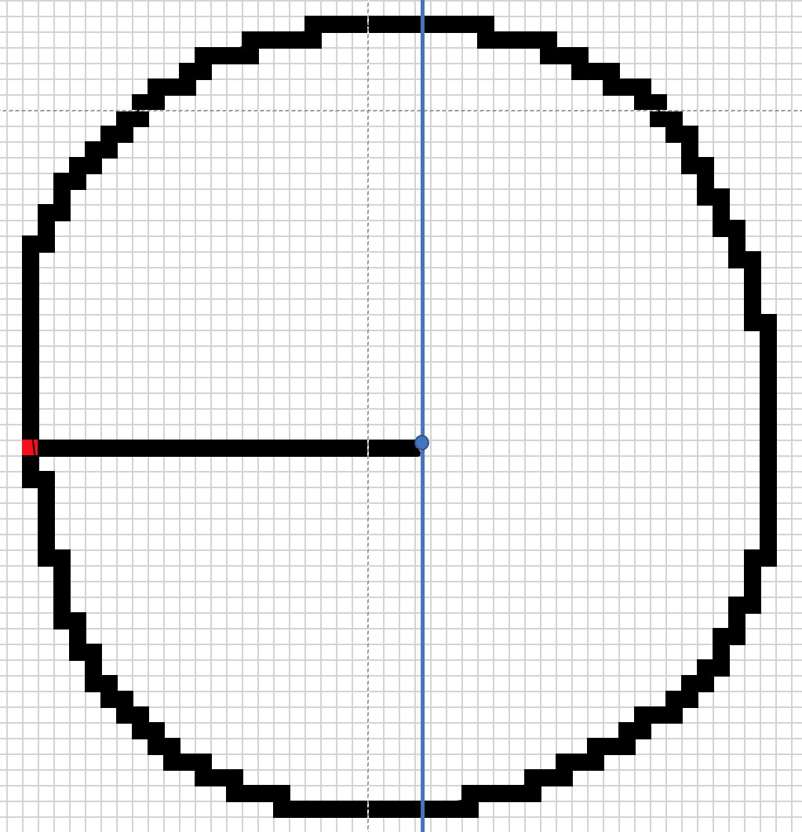
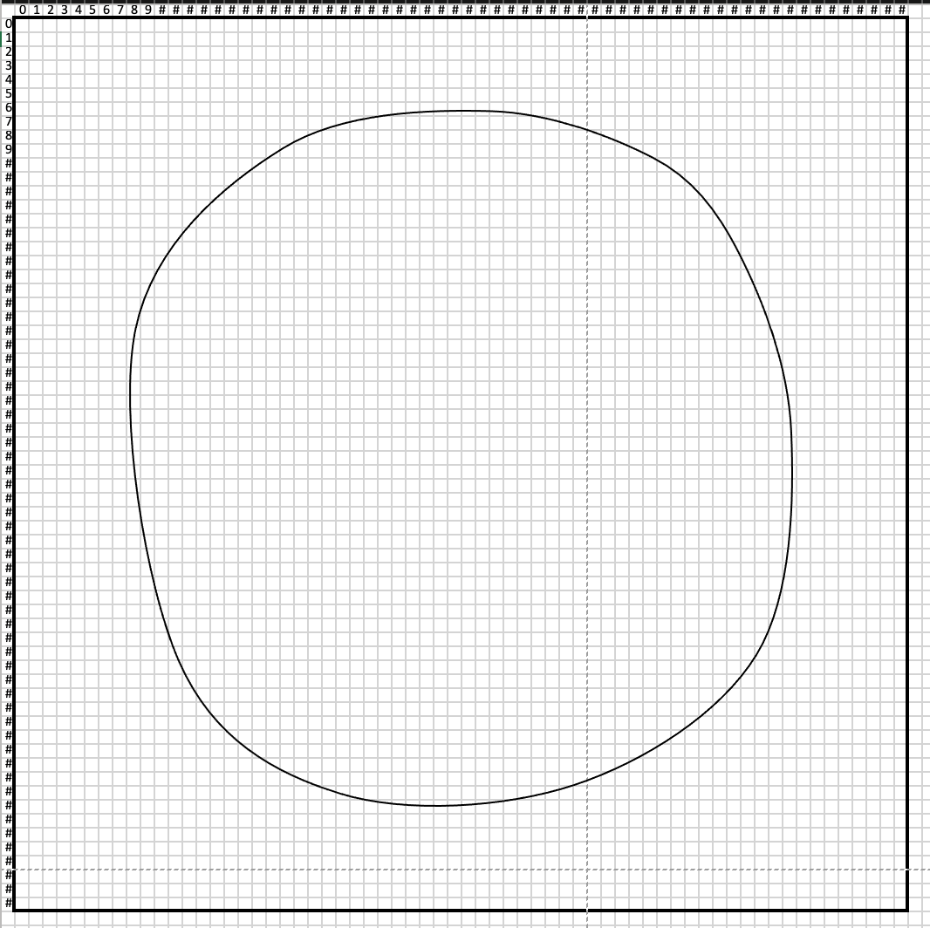
- Edge detect exterior pixels along curve
- Find centroid of droplet
- Calculate characteristic radius for each row
- Compute volume for each slice
- Total volume for each respective side
- Average left and right sides
Centroid Shell Method

Slide 8
Pixel Identification
0
Column
63
Before locating centroid of droplet, pixels will be identified using 64 x 64 grid
Convert image format to XY format
0
0
1
2
Row
0
v
1
v
v
X
2
Image Format: [row, column]
XY Format: (column, row)
Example: Centroid of image pixel format [C , R] = [0,1]
XY Format (P_{x ,} P_{y}) = (1.5, 0.5)
Y
63

Slide 9
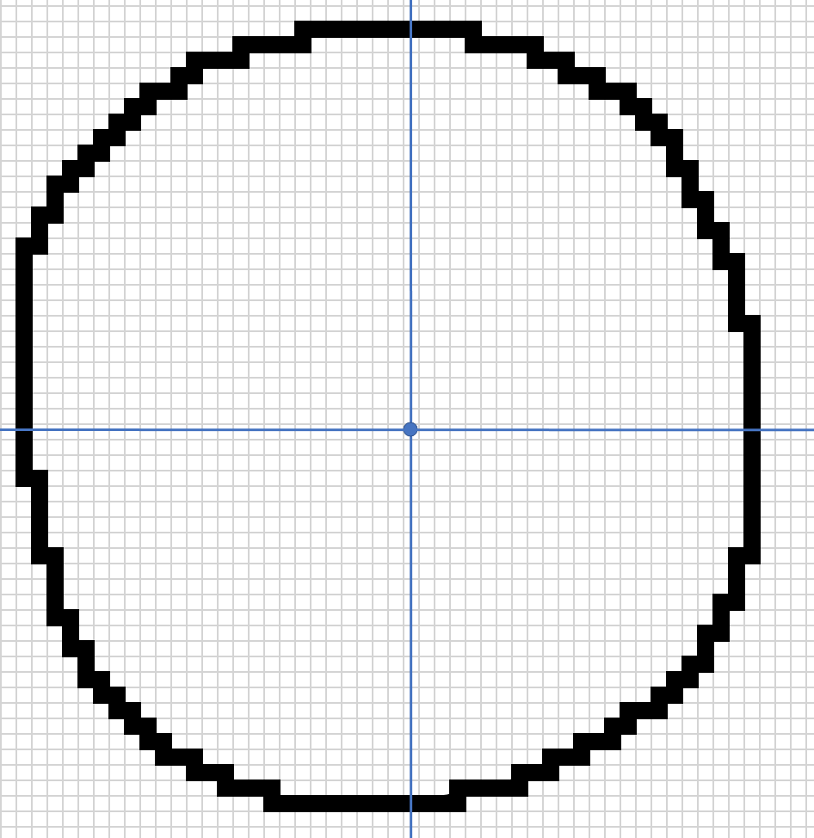
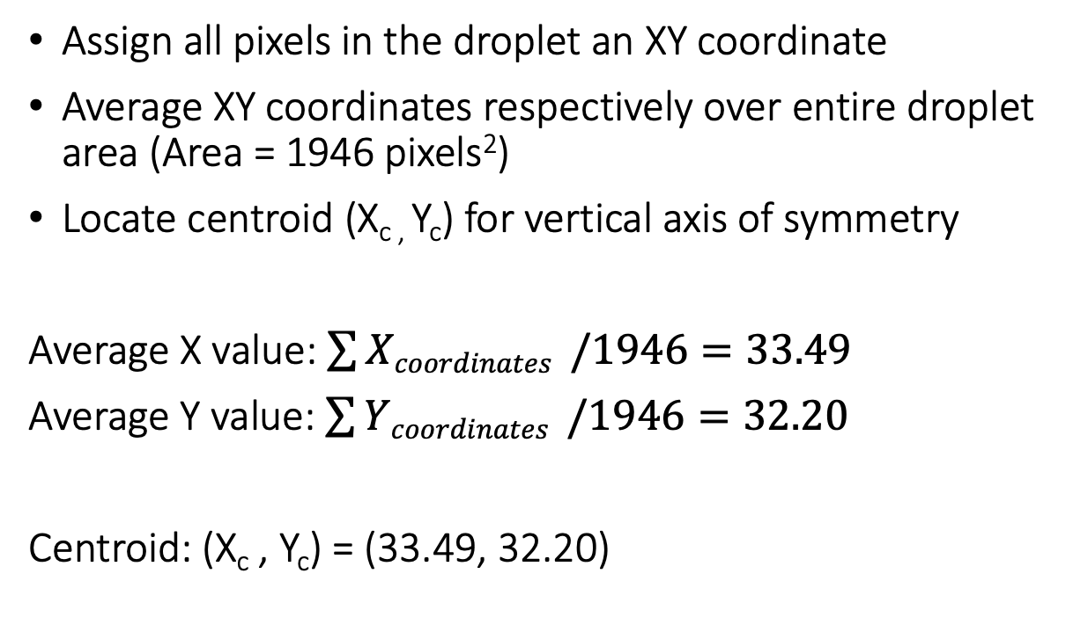
Find Centroid
Assign all pixels in the droplet an XY coordinate
Average XY coordinates respectively over entire droplet area (Area = 1946 pixels²)
Locate centroid (X_{c ,} Y_{c}) for vertical axis of symmetry
Average X value: $\sum{Xcoordinates }/1946=33.49$
Average Y value: $\sum{Ycoordinates }/1946=32.20$
Centroid: (X_{c} , Y_{c}) = (33.49, 32.20)

Slide 10
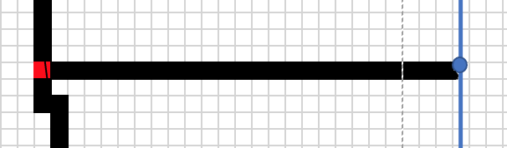
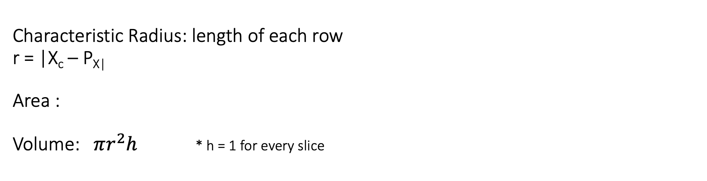

Example Slice
Characteristic Radius: length of each row
r = |X_{c} – P_{X|}
Area :
Volume: $πr^{2}h$ * h = 1 for every slice
Point P = (P_{x} , P_{Y})
(8.5, 33.5)
$$πr^{2}$$
Example: r = |33.49 – 8.5| = 24.99 = 25 pixels → Volume = $π{\left(25\right)}^{2}\left(1\right)=1963.50 cubic pixels$

Slide 11
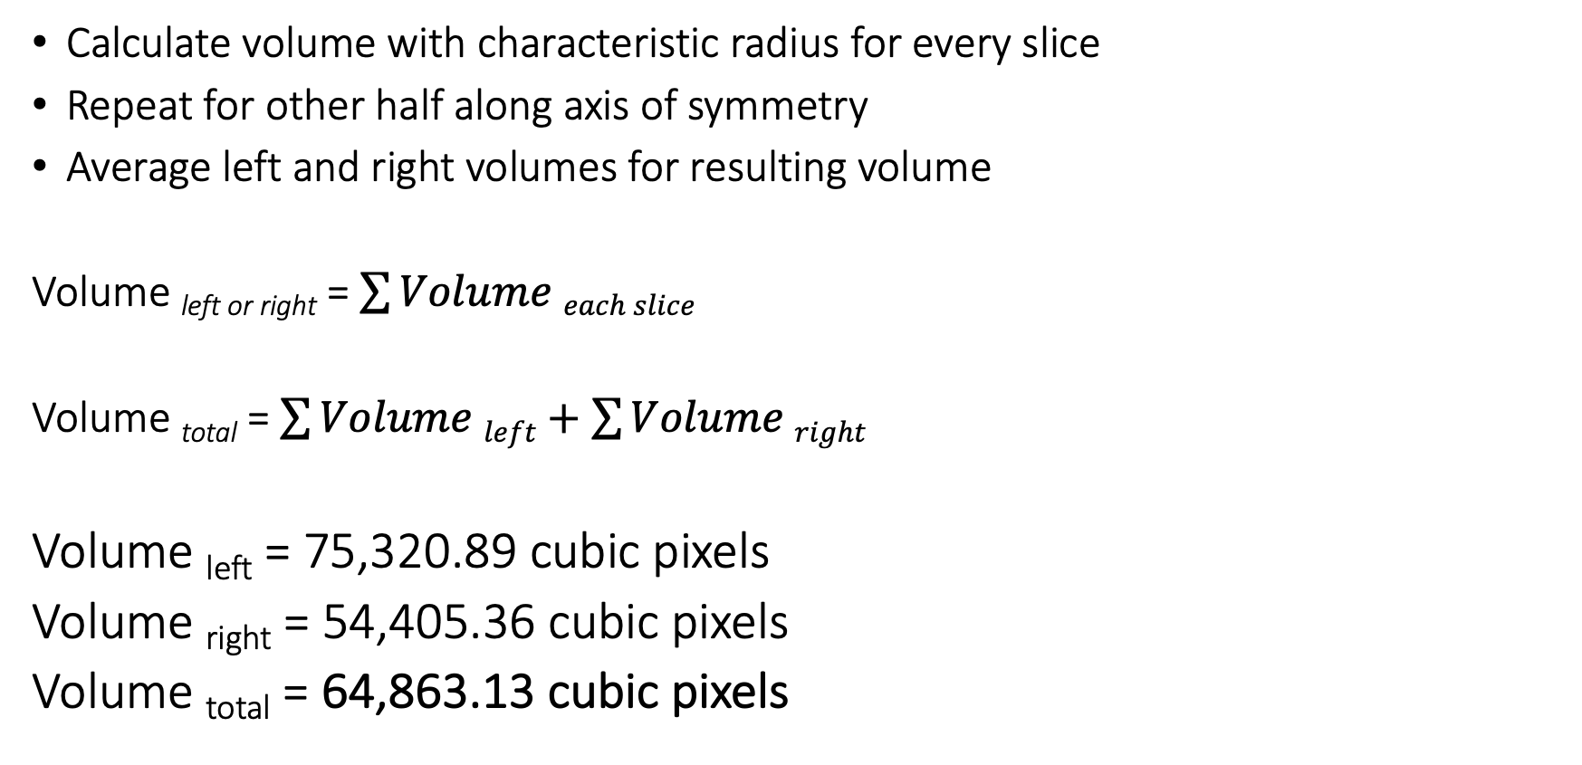
Resulting Volume for Shell Method
Calculate volume with characteristic radius for every slice
Repeat for other half along axis of symmetry
Average left and right volumes for resulting volume
Volume _{left or right} = $\sum{Volume each slice}$
Volume _{total} = $\sum{Volume left+\sum{Volume right}}$
Volume _{left} = 75,320.89 cubic pixels
Volume _{right} = 54,405.36 cubic pixels
Volume _{total} = 64,863.13 cubic pixels

Slide 12
Legendre Polynomial Method
Edge detection is done on a sub-pixel basis to recover the discrete edge lost on the digitization process
A digital image is converted into rapid changing profile of pixel intensities
Two steps:
- Coarse edge detection
- Fine sub-pixel detection

Slide 13
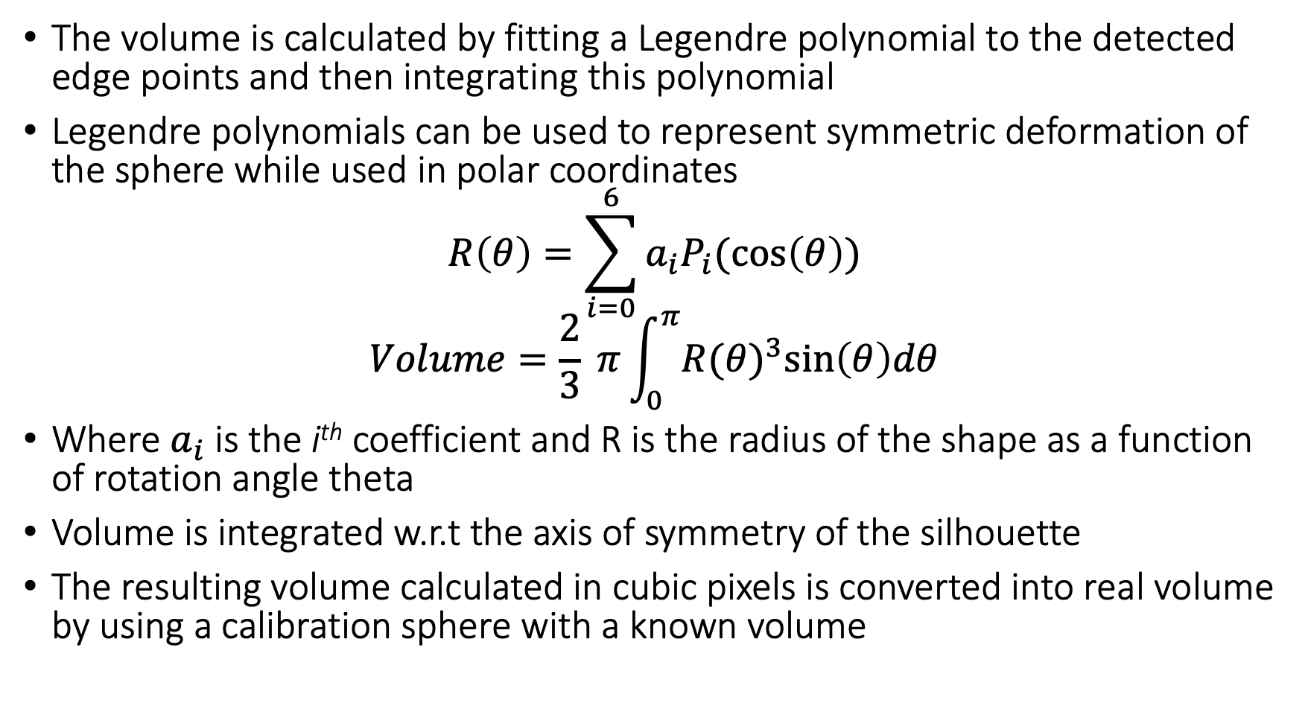
Legendre Polynomial Method
The volume is calculated by fitting a Legendre polynomial to the detected edge points and then integrating this polynomial
Legendre polynomials can be used to represent symmetric deformation of the sphere while used in polar coordinates
$$R\left(θ\right)=\sum_{i=0}^{6}{a_{i}P_{i}(\cos\left(θ\right))}$$
$$Volume=\frac{2}{3} π\int_{0}^{π}{R{(θ)}^{3}\sin\left(θ\right)dθ}$$
Where $a_{i}$ is the i^{th} coefficient and R is the radius of the shape as a function of rotation angle theta
Volume is integrated w.r.t the axis of symmetry of the silhouette
The resulting volume calculated in cubic pixels is converted into real volume by using a calibration sphere with a known volume

Slide 14
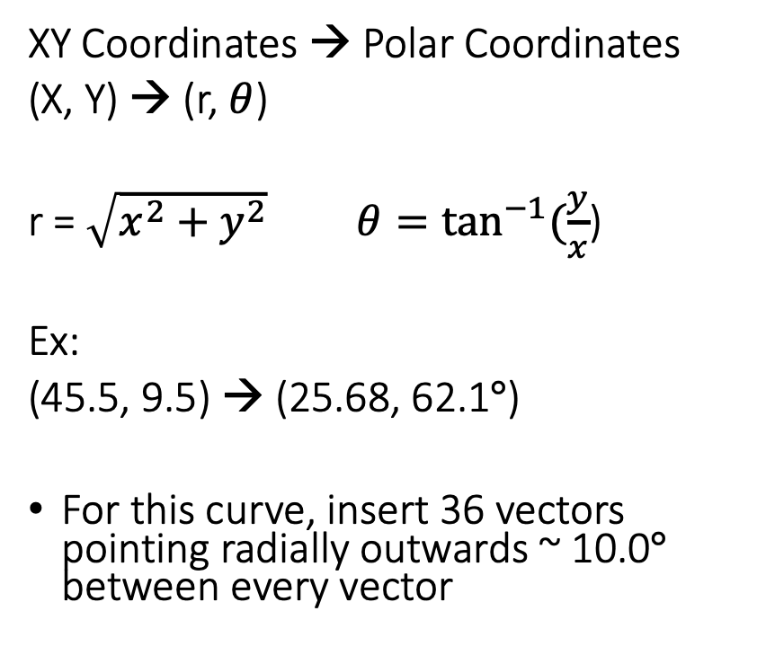

90º
XY Coordinates → Polar Coordinates
(X, Y) → (r, $θ$)
r = $\sqrt{x^{2}+y^{2}} θ=\tan^{−1}{(\frac{y}{x}}$)
Ex:
(45.5, 9.5) → (25.68, 62.1$°$)
For this curve, insert 36 vectors pointing radially outwards ~ 10.0$°$ between every vector
(45.5, 9.5)
R = 25.68 pixels
Y = 32.2 – 9.5 = 22.7
62.12$°$
X = 45.5 – 33. 5 = 12

Slide 15
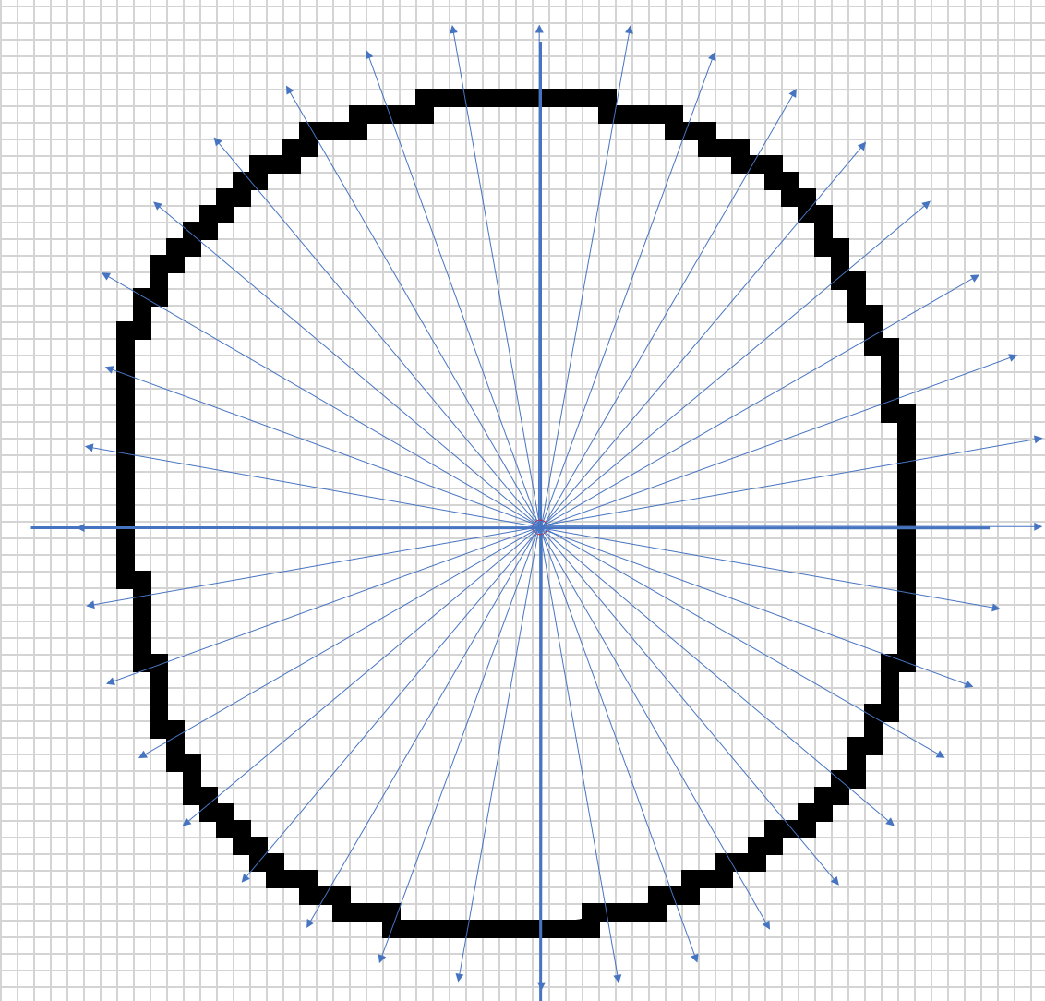
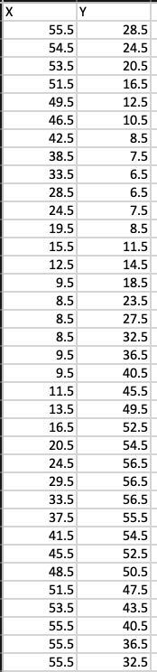
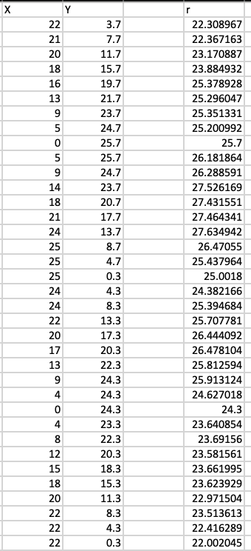
X and Y Distance→ r
(X,Y) Coordinates

Slide 16
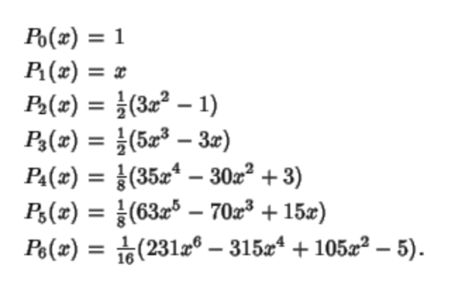

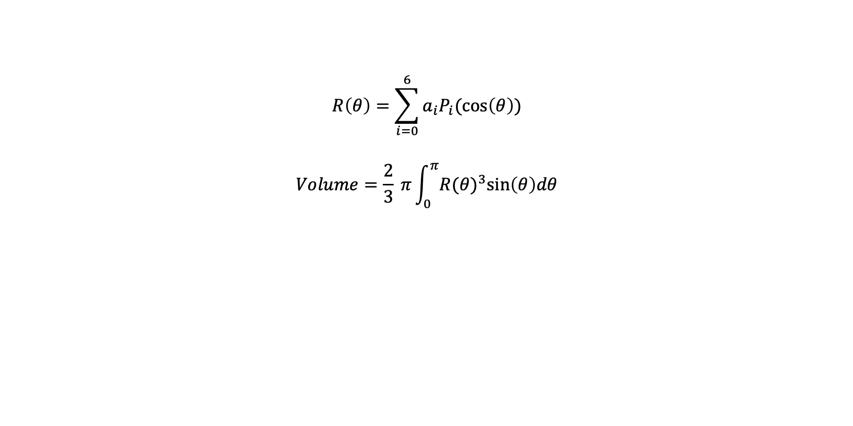
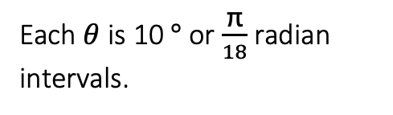
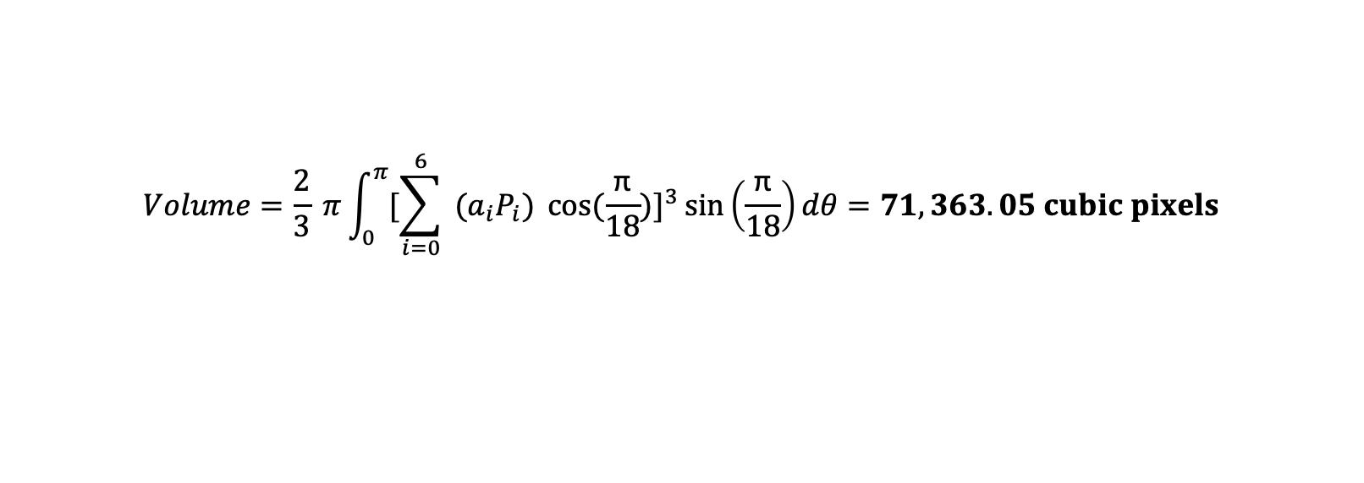
Volume Calculations
$$R\left(θ\right)=\sum_{i=0}^{6}{a_{i}P_{i}(\cos\left(θ\right))}$$
$$Volume=\frac{2}{3} π\int_{0}^{π}{R{(θ)}^{3}\sin\left(θ\right)dθ}$$
$$Volume=\frac{2}{3} π\int_{0}^{π}{[{\sum_{i=0}^{6}{a_{i}P_{i}\cos\left(θ\right)}]}^{3}\sin\left(θ\right)dθ}$$
Each $θ$ is 10 $°$ or $\frac{\text{π}}{18}$ radian intervals.
$$Volume=\frac{2}{3} π\int_{0}^{π}{[{\sum_{i=0}^{6}{ (a_{i}P_{i}) \cos{(\frac{\text{π}}{18}}})]}^{3}\sin\left(\frac{\text{π}}{18}\right)dθ}=71,363.05 cubic pixels$$

Slide 17
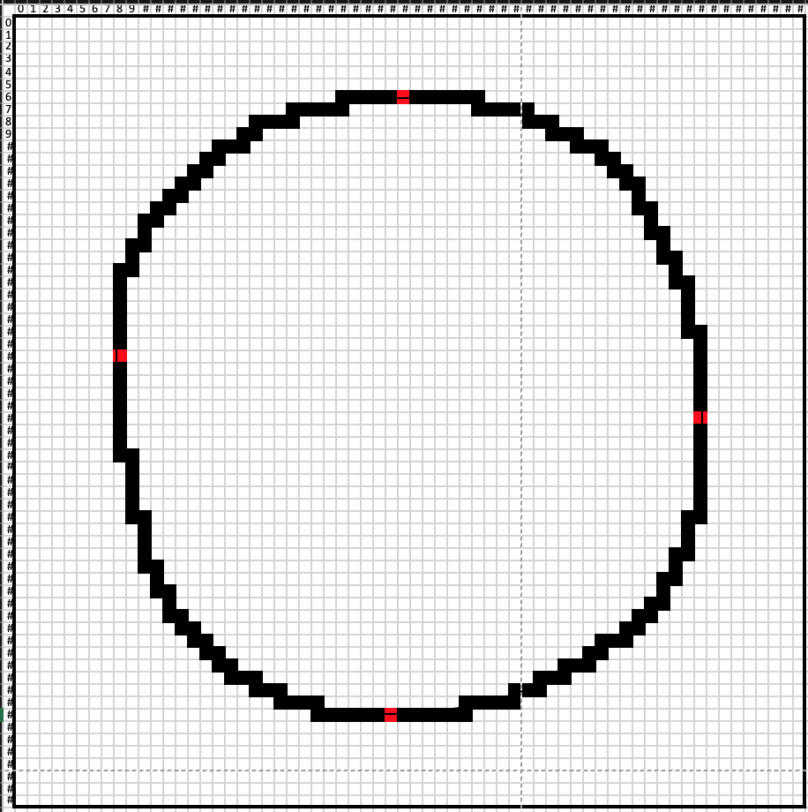
Edge Extreme Method
[31.5,6.5]
Find the highest, lowest, right and left-most points from the centroid
Calculate height and width using the individual pixel length
Use width and height to calculate radius and resulting volume.
[8.5, 27.5]
[55.5,32.5]
[30.5,56.5]
Highest point = row closest to row zero, median pixel = row 6, Y value of 6.5
Lowest point = row farthest from row zero, median pixel = row 56, Y value of 56.5
Right point = column farthest from column zero, median pixel = column 55, X value of 55.5
Left point = column closest to column zero, median pixel = column 8, X value of 8.5

Slide 18


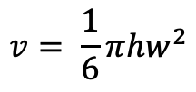

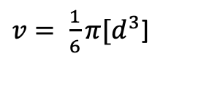

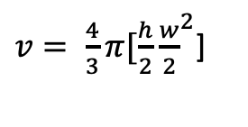
Edge Extreme Volume
h
w
$v= \frac{4}{3}π{[\frac{h}{2}\frac{w}{2}}^{2}$]
w
$$Height=\left(upper − lower\right)∗pixelLength$$
$$Width=\left(right − left\right)∗pixelLength$$
$v= \frac{1}{6}π{[d}^{3}$]
$$Height=\left|\left(6.5 −56.5\right)∗1\right|=50$$
$$Width=\left|\left(55.5 −8.5\right)∗1\right|=47$$
$$v= \frac{1}{6}π{hw}^{2}$$
$v= \frac{1}{6}π{(50)(47)}^{2}$ = 57,831.5 cubic pixels

Slide 19
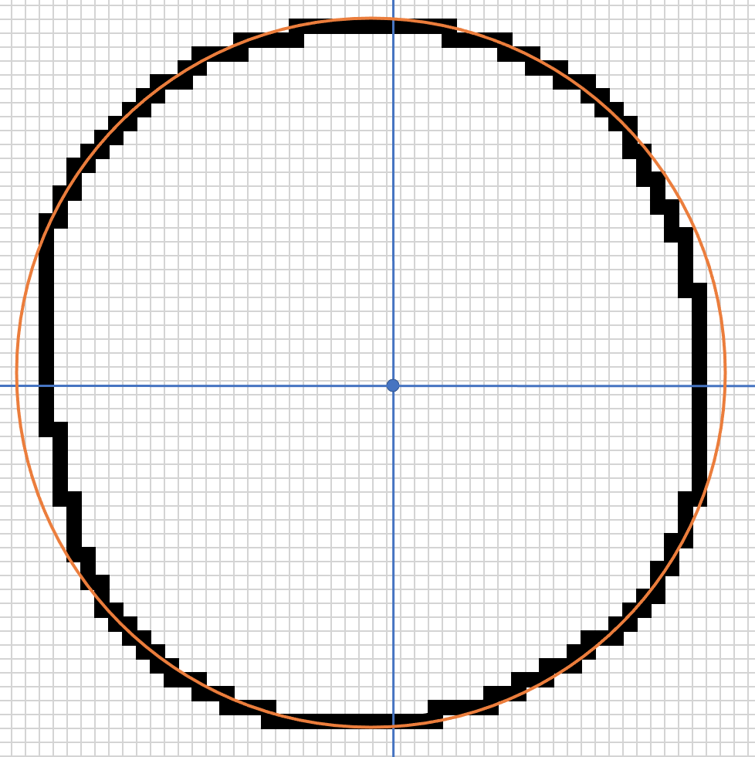






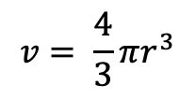
Pixel Summation Method
Method: Find pixel count (pixel area) to calculate the resulting singular radius and volume.
Pixel Count = 1,946 pixels
Pixel Area = 1,946 pixels
$$r= \sqrt{\frac{A}{π}}$$
$$r= \sqrt{\frac{1946}{π}}$$
$$A=πr^{2}$$
$$r=24.88$$
$$v= \frac{4}{3}πr^{3}$$
$v= \frac{4}{3}π{(24.88}^{3}$)
$$v=64,574.1$$
= Circle of radius 24.88

Slide 20
Comparison
Method | Volume (cubic pixels) | Percent Difference
Edge Extreme | 57,830 | - 20.9%
Pixel Summation | 64,570 | - 10.0%
Centroid Shell | 54,400 – 75,300 | - 9.54%
Legendre Polynomial | 71,360 | ----
Legendre Polynomial method is the most precise in its calculations by integrating volumes for each respective radius as a function of theta. If a finer sub-pixel edge detection was imposed on the test curve, the volume would be even more accurate.
The pixel summation assumes a singular radius for the entire droplet making this method the least accurate, even though the pixel area is analytically correct.
Although the edge extreme accounts for the height and width of the droplet, the ellipsoidal assumption in the method will not properly account for any non-uniform droplet curves.
The shell method is another accurate and precise technique but creates error depending on the thicknesses of the slice heights.
However, for a quick volume estimation the less accurate methods will suffice.

Slide 21
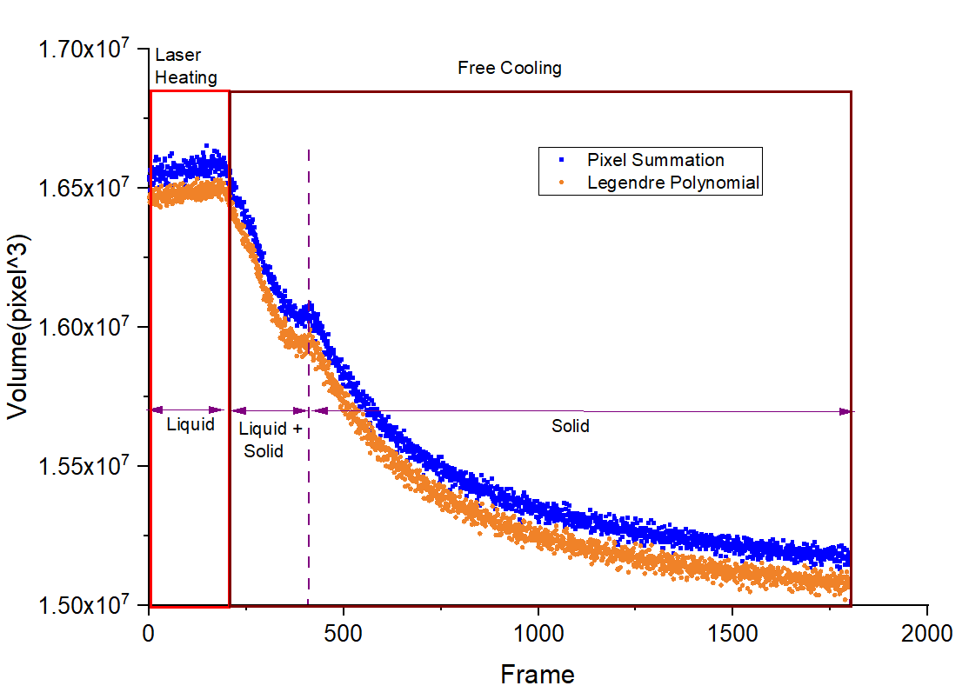
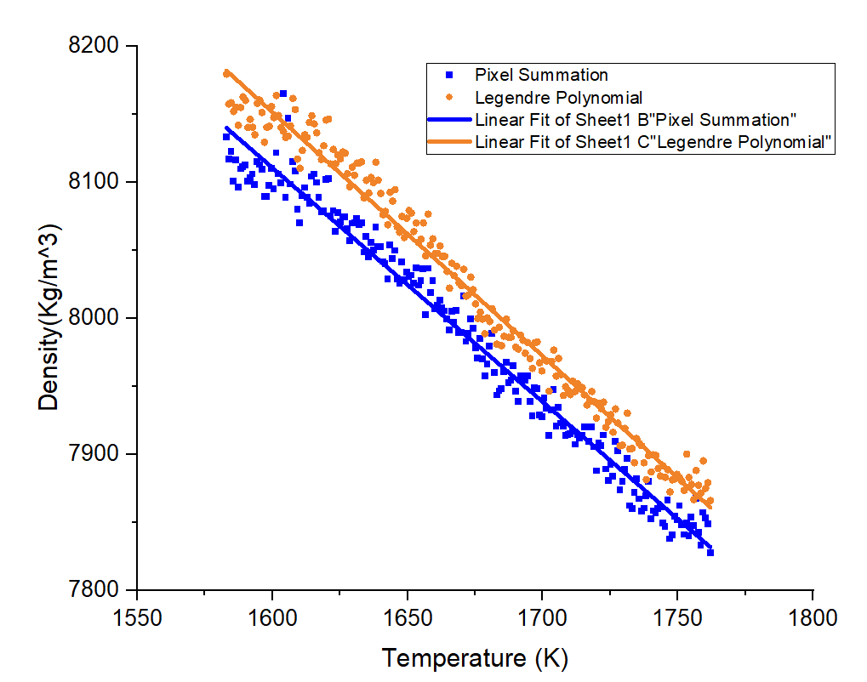
CMSX-4 plus
Figure Courtesy of Jannatun Nawer
Method | $ρ_{0}$ | $$\frac{dρ}{dT}$$
Pixel Summation | 8015.96277$±1.00775$ | 1.72234$±$0.01839
Legendre Polynomial | 8052.93865$±$0.93291 | 1.79481$±$0.01703
$${ρ=ρ}_{0}+\frac{dρ}{dT}(T−T_{m})$$

Slide 22
Going Forward
Perform each method analytically to compare accuracy and precision. ✓
Complete optimized and rotated shell methods.
Test these methods on acoustic, EML, and ESL droplets to quantify the deviation from ideal deformation behavior.
  Prepare the raw EML data and develop automatic program.
Quantify the different forms of failure and detect a possible pattern in the data.

Slide 23
Thank you!
Questions?

Slide 24
Edge Detection and Resulting Volume Calculation Methods for Liquid Droplet Property Measurement
Alexandra Talbot
Method | Volume (cubic pixels) | Percent Difference
Edge Extreme | 57,830 | - 20.9%
Pixel Summation | 64,570 | - 10.0%
Centroid Shell | 54,400 – 75,300 | - 9.54%
Legendre Polynomial | 71,360 | ----
Pixel Area = 1,946 pixels
Figure Courtesy Jannatun Nawer

